Slide 1
Adventures in CS
&&
Neural Networks
Roman Hayn

Slide 2
Basics && Types of NN
My Text based Project
Current State of NN

Slide 3
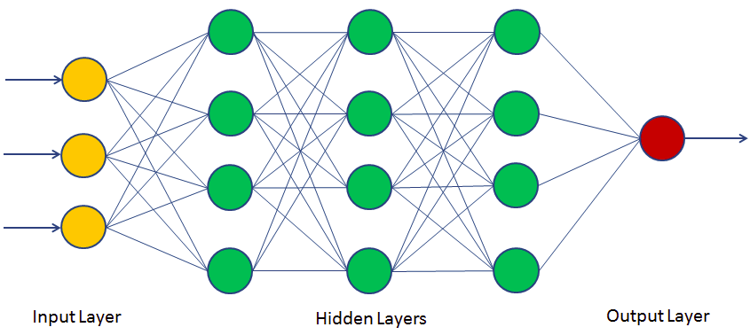
Typical Layout - NN

Slide 4
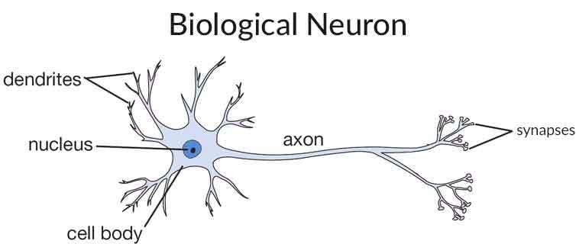
Basic Neural Networks - NN

Slide 5
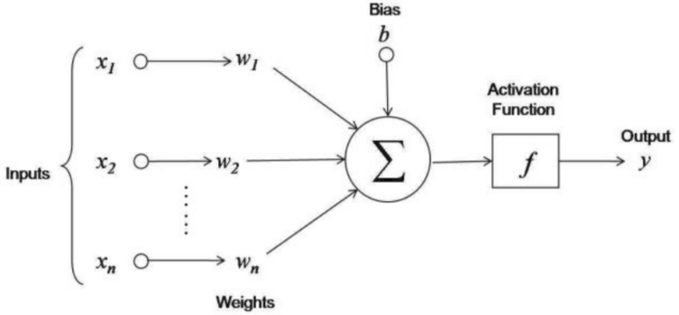
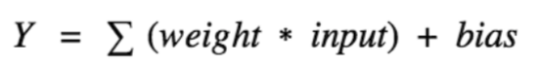
Basic Neural Networks - NN

Slide 6
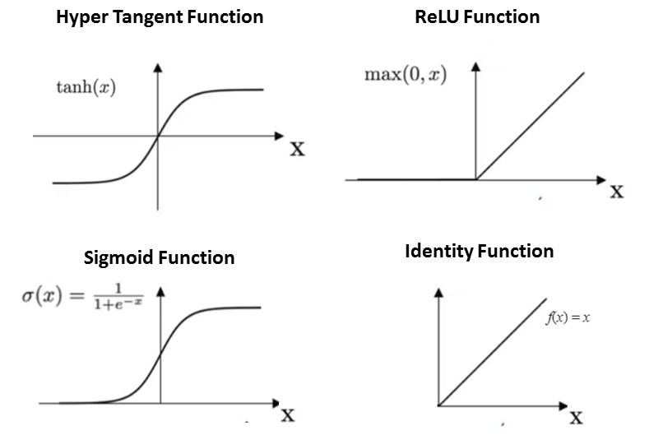

Slide 7
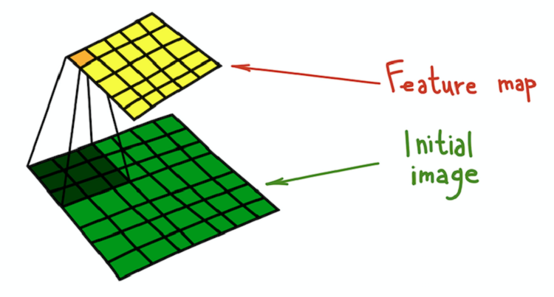
Convolutional Neural Networks - CNN

Slide 8


Slide 9
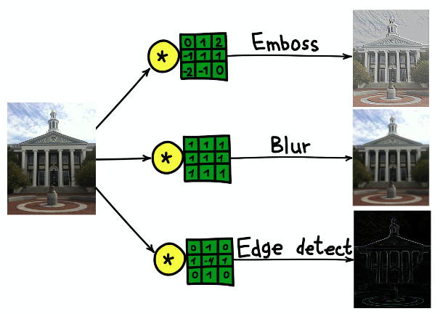

Slide 10


Slide 11

Recurrent Neural Network - RNN

Slide 12
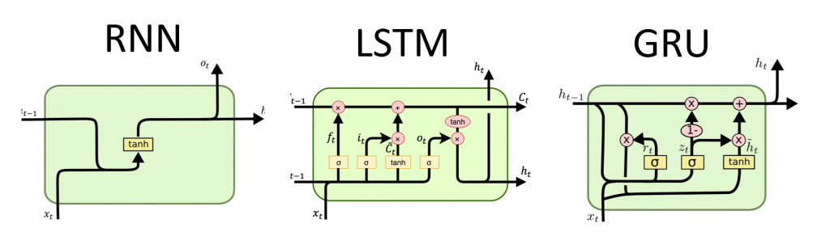
Recurrent Neural Networks

Slide 13
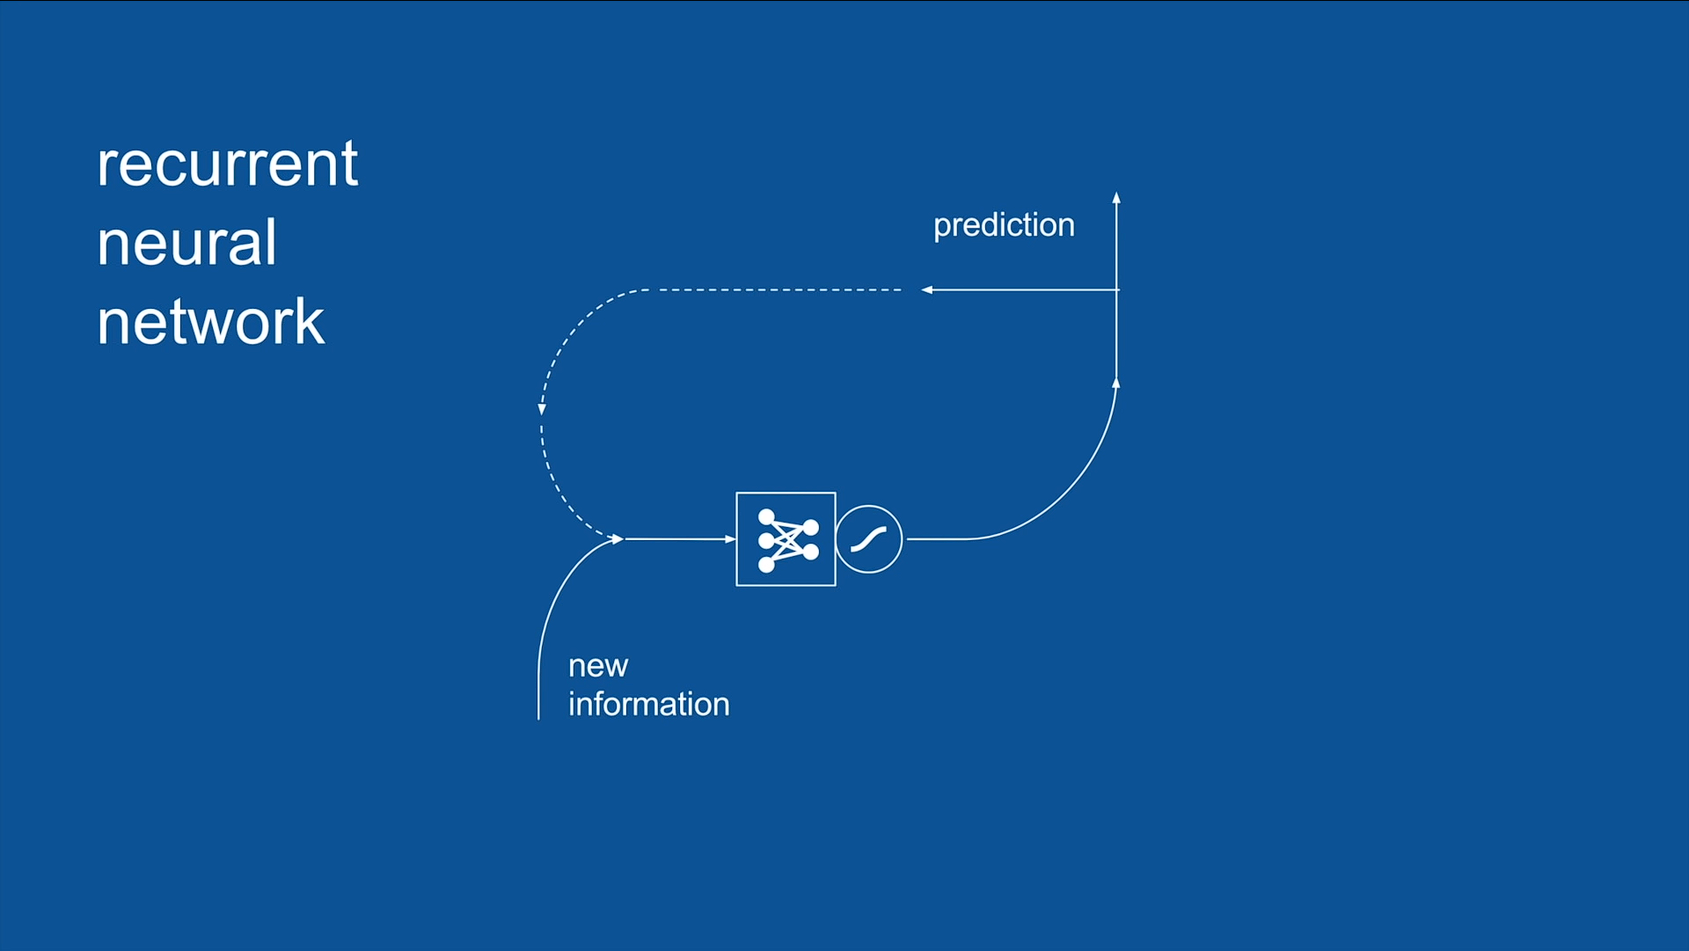

Slide 14
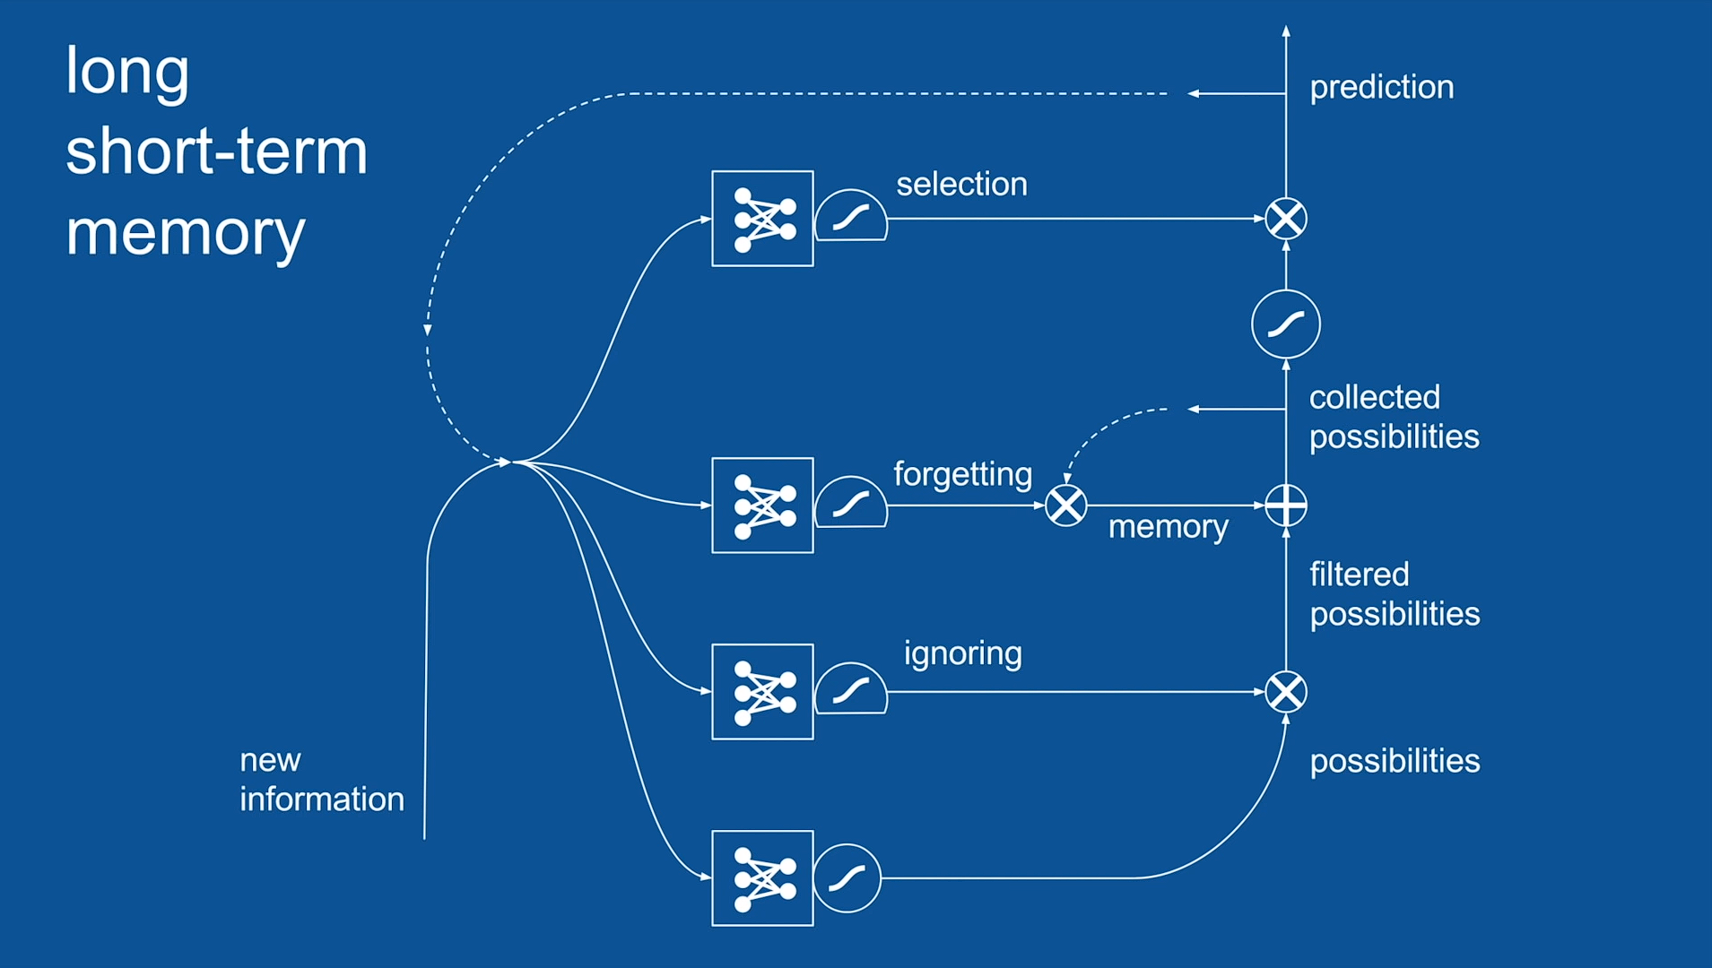

Slide 15
My text based Project

Slide 16

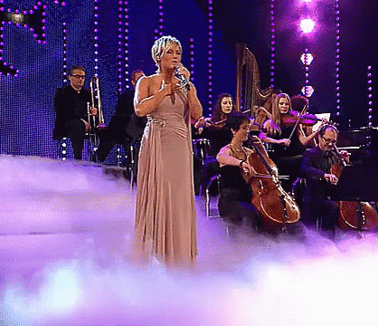


Slide 17

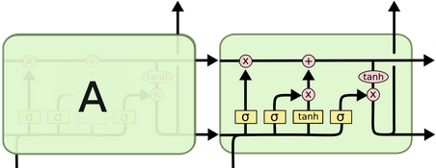


Slide 18
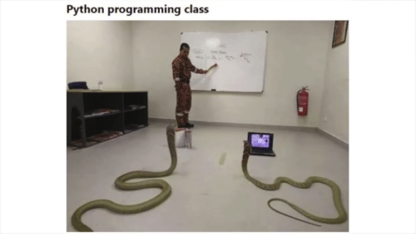
Scraping the web for Data

Slide 19

Web Scraping made Easy with Python
Requests
LXML.HTML (XPath)
PyMySQL

Slide 20



Artist, Title, Lyrics

Slide 21
A Look at the Lyrics
882 Artists
13.664 Lyrics in total
6.510 Lyrics (filtered)
~9MB

Slide 22
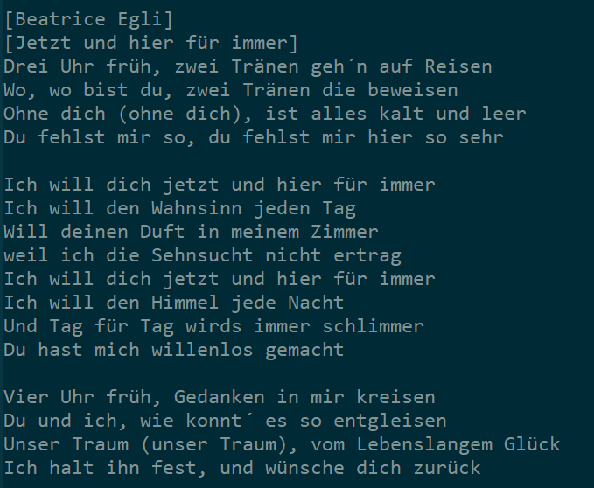

Slide 23
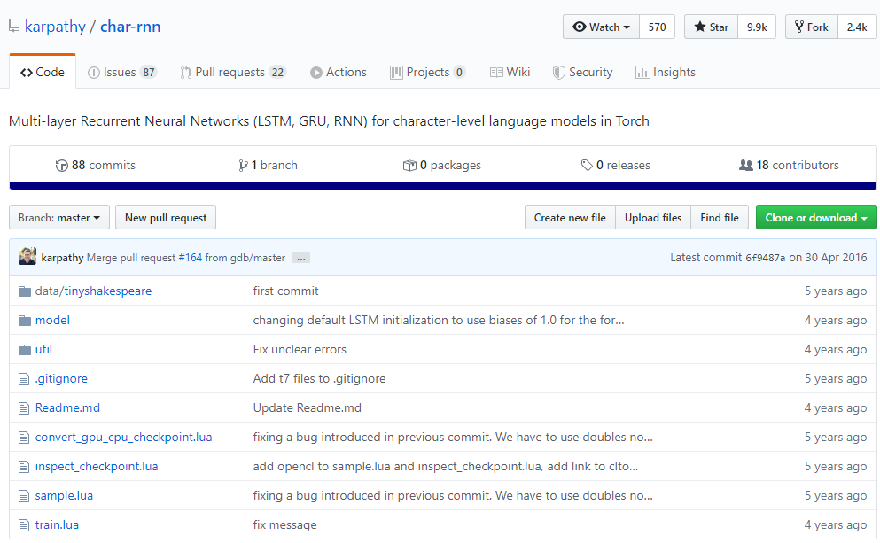

Slide 24
My own LSTM Neural Network
Layer size: 640
LSTM Layers: 2
Number of Neurons: 1280
Total Time to Learn: ~8:30h

Slide 25
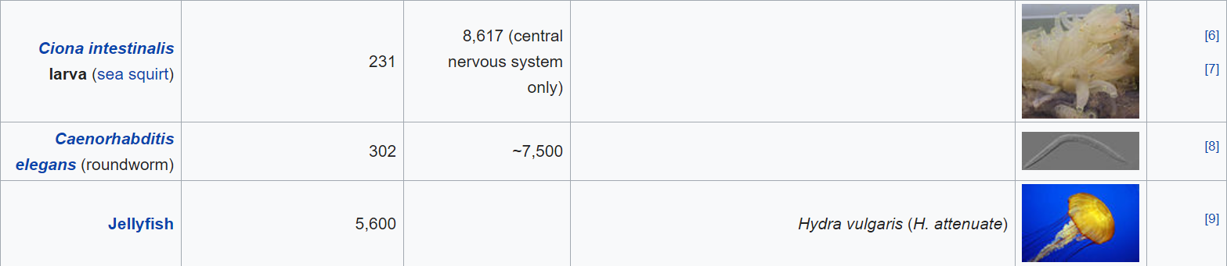
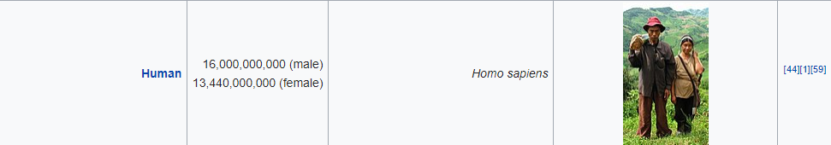

Slide 26
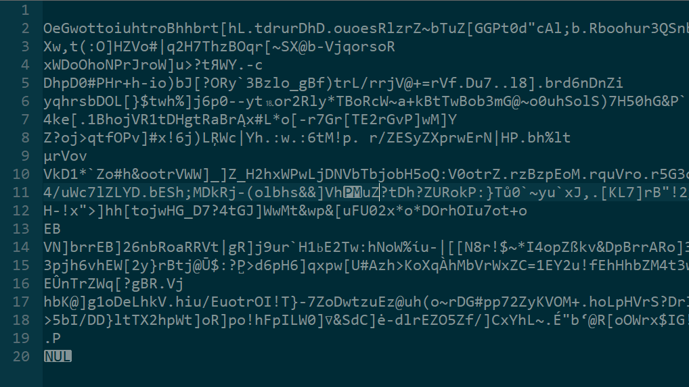
Loss:
5.1176
0:00h

Slide 27
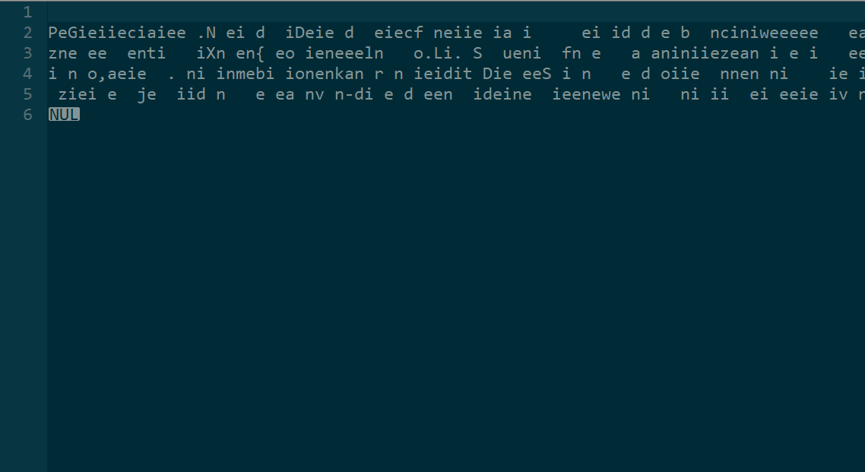
Loss:
4.0901
0:01h

Slide 28
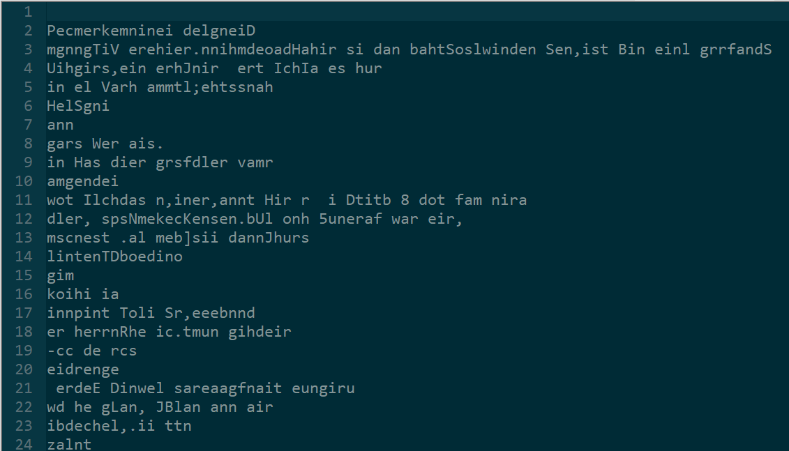
Loss:
2.7687
0:11h

Slide 29
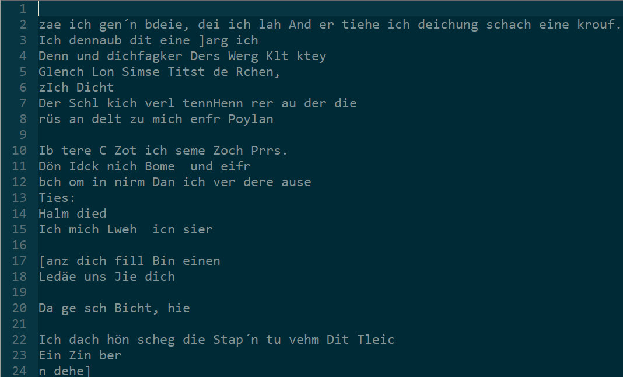
Loss:
2.2000
0:19h

Slide 30
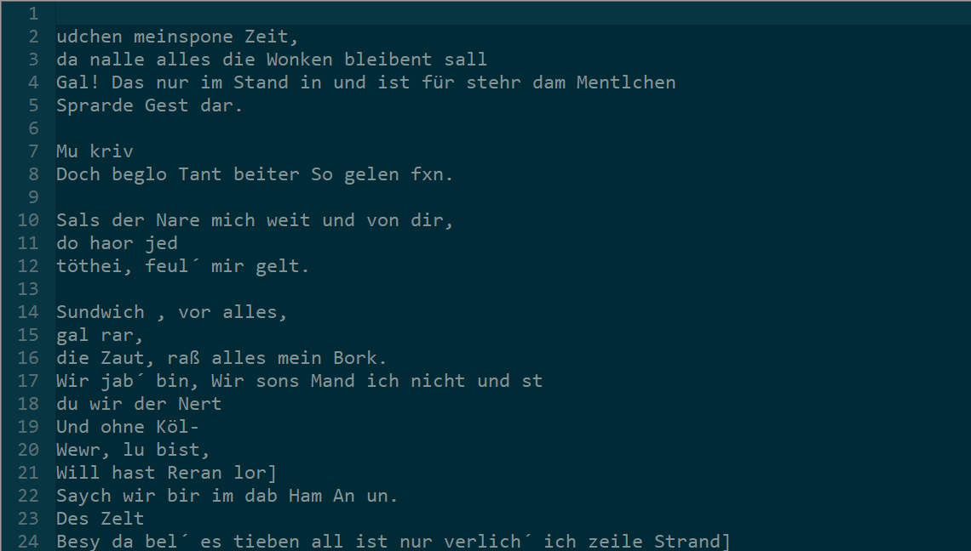
Loss:
1.8516
0:29h

Slide 31
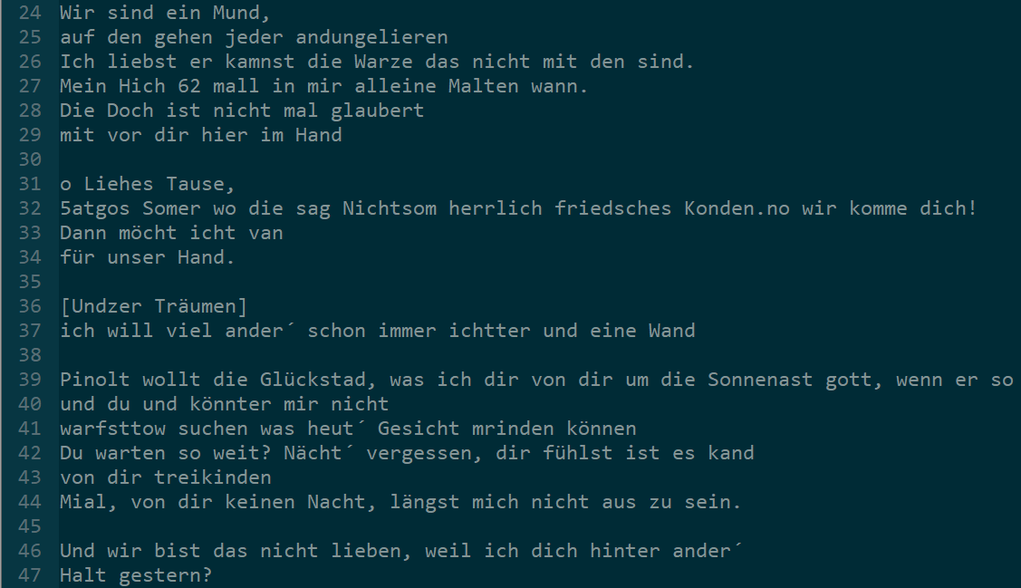
Loss:
1.5790
0:57h

Slide 32
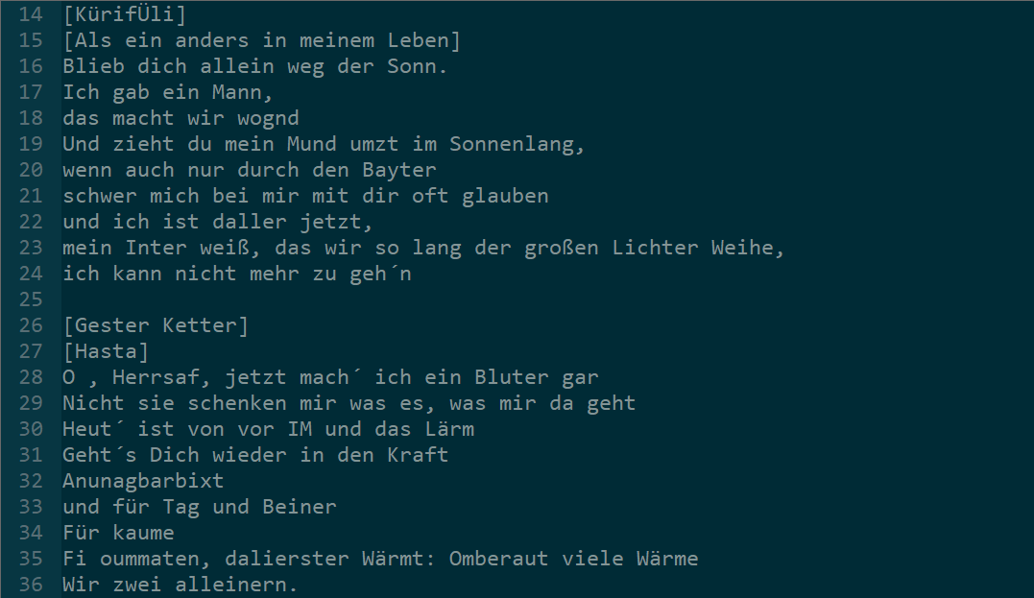
Loss:
1.4236
1:53h

Slide 33
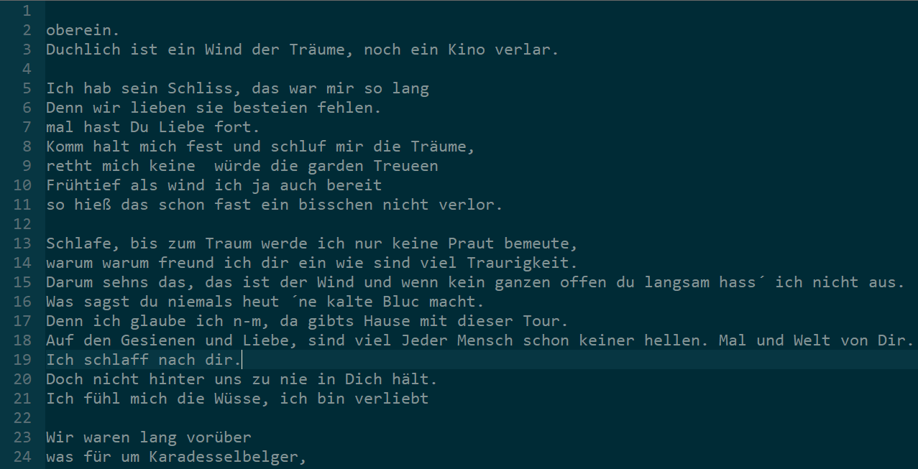
Loss:
1.3432
2:50h

Slide 34
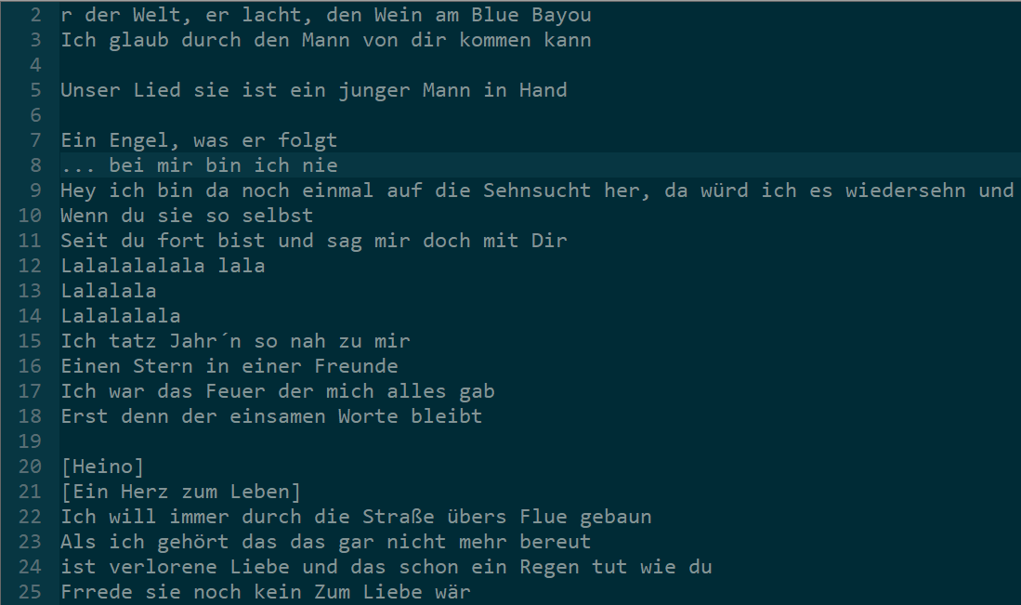
Loss:
1.2531
5:11h

Slide 35
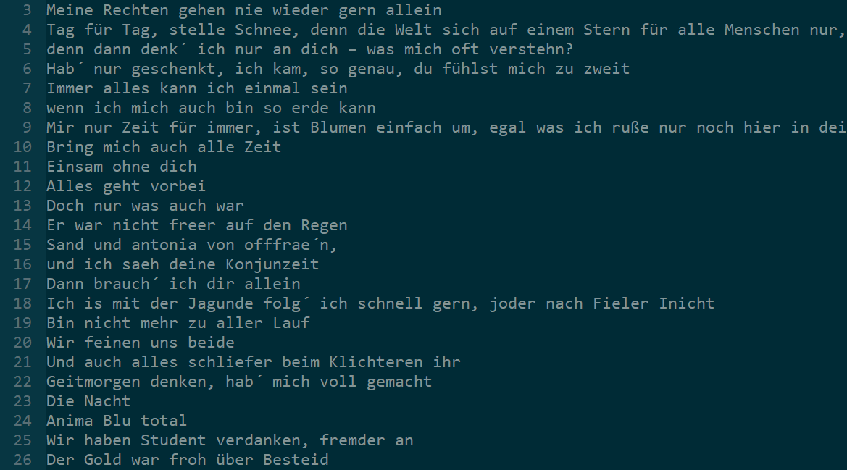
Loss:
1.1646
8:29h

Slide 36
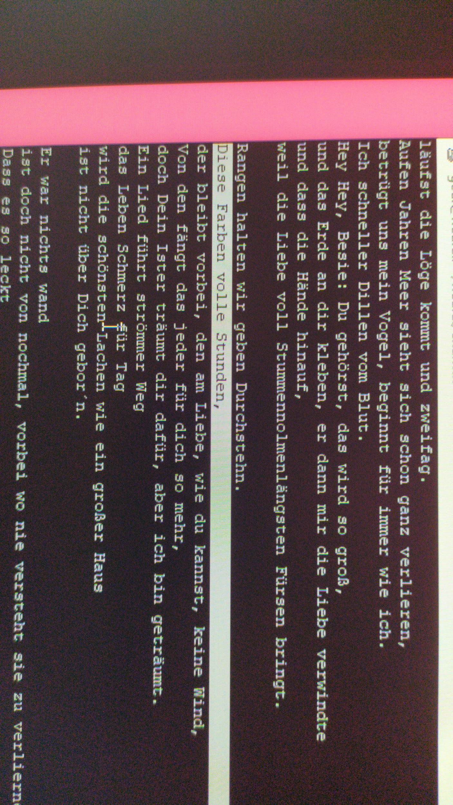
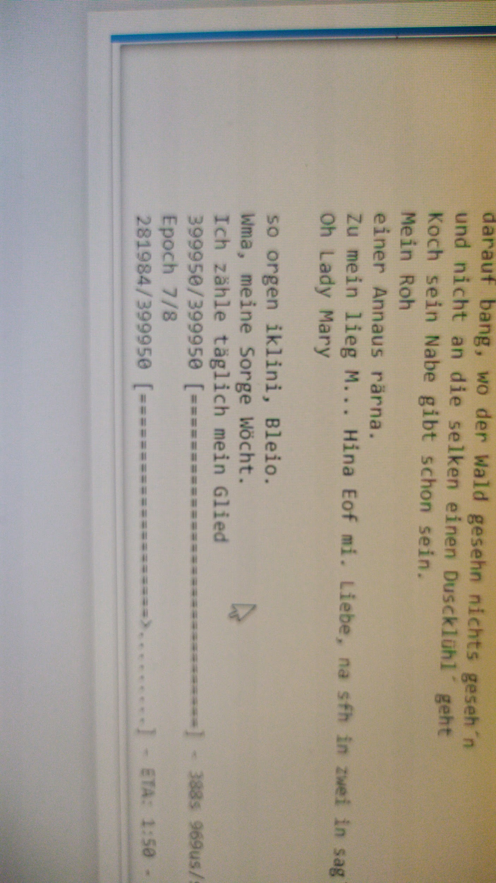
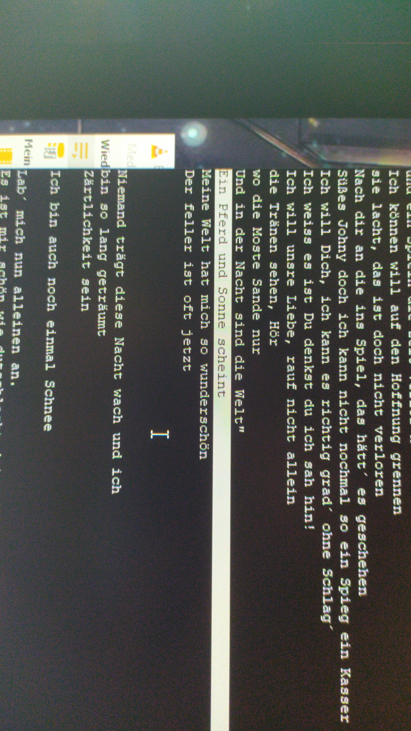
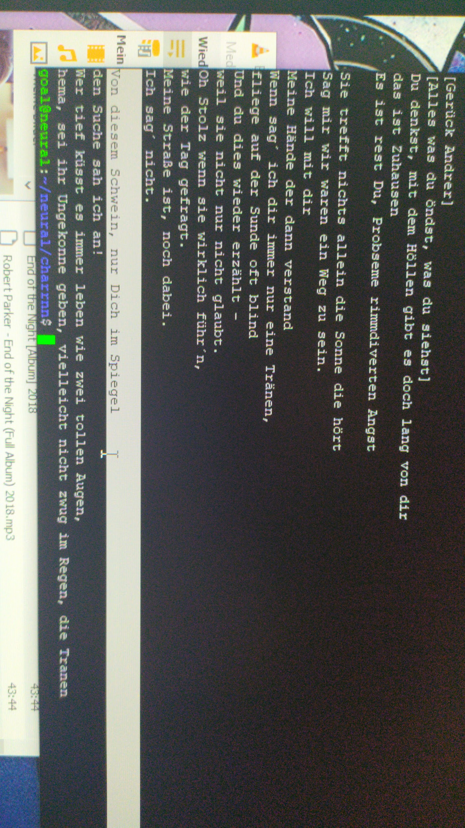

Slide 37
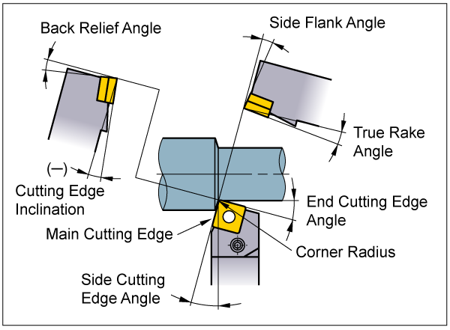

Slide 38


Slide 39
Andrej Karpathy
Brandon Rohrer
Cary Huang (CaryKH)
Primer
sentdex
Two Minute Papers
The Thought Emporium

Slide 40
www.datacamp.com
software.intel.com
towardsdatascience.com
dprogrammer.org
NOT wikipedia.org
songtexte.com
medium.com
wiki.tum.de

